Slide 1

Query Builder
Submitted by:-
Vinod Kushwaha
(1413210182)
Vikas Kumar Jaiswal
(1413210179)
Sudhanshu Rohit
(1413210166)
Submitted to:-
Mr. Harinder Malik

Slide 2
Content
Introduction
Working tools
Creation of Query
Login Page
Create New Table
Table
Update Records
Multiple Field Search
Database Design
UML Design
Testing
Conclusion

Slide 3
Introduction
Query Builder provides a graphical user interface(GUI) for handling queries. It is a standalone application based on java to provide GUI for handling Queries and will help in fetching related data from the database.

Slide 4
Working tools
Java
Platform- Netbeans
Oracle 11g
GUI tool- Java Fx

Slide 5
Creation of Query Builder
All the above four tools are used according to their requirement for making this application by writing codes and by creating components with the help of GUI and by linking it with the database. It would have several other features such as in menu bar files will be there.

Slide 6
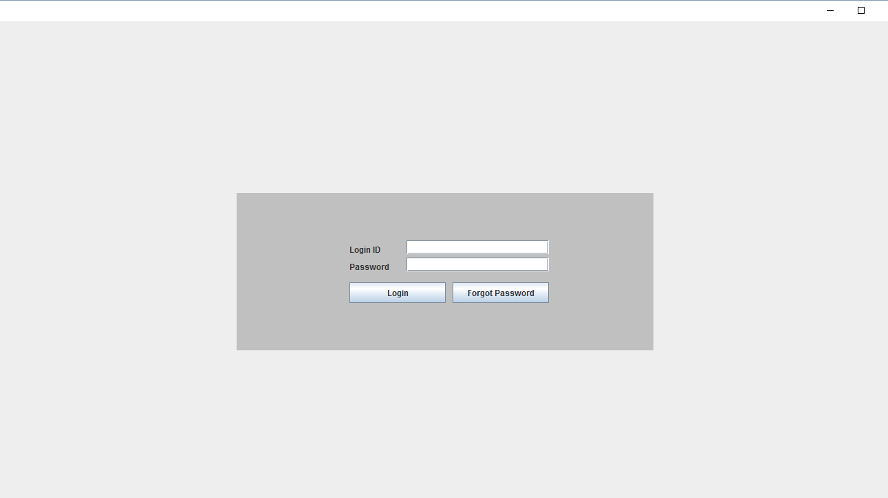
Login Page
User name and password are required for authentication of user to acess database.

Slide 7
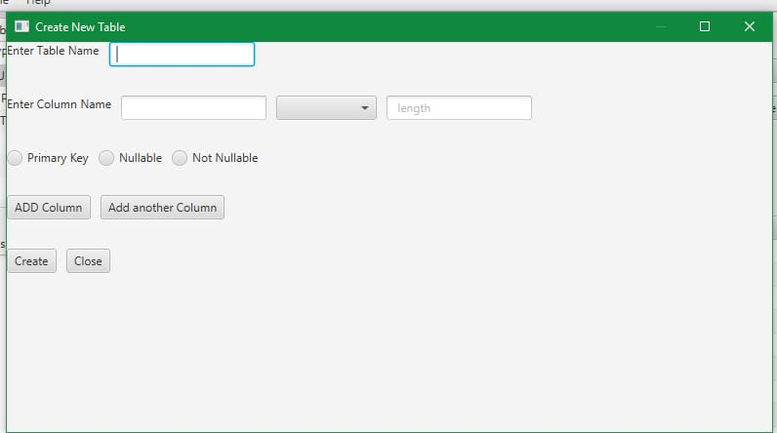
Create New Table
It carries several features such as
Enter Table Name
Enter Column Name
Primary Key
Not Null
Add Column
Add another Column
Create
Close

Slide 8
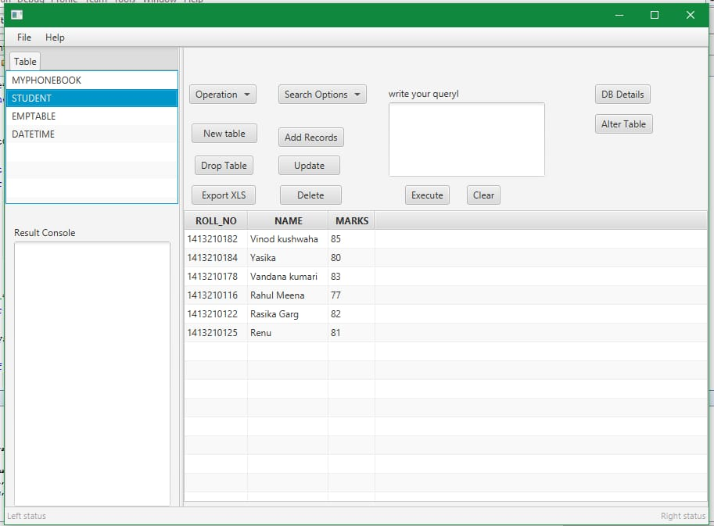
Table
It carries records carrying several features that would be in terms of
MYPHONEBOOK
STUDENT
EMPTABLE
DATETIME

Slide 9
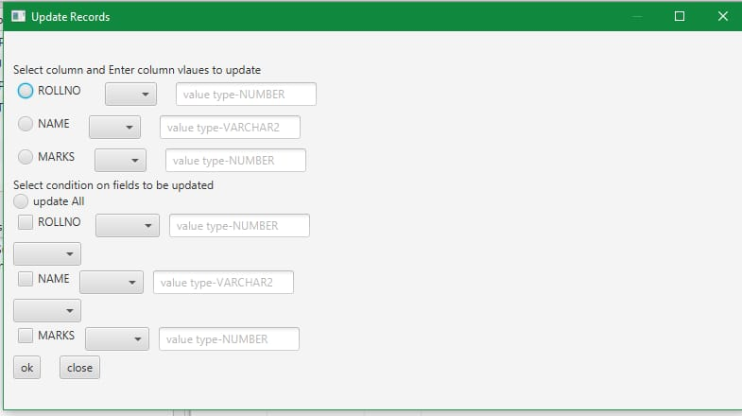
Update Records
It carries several features such as
Select Column and Enter Column Values to Update
Select condition on fields to be updated

Slide 10
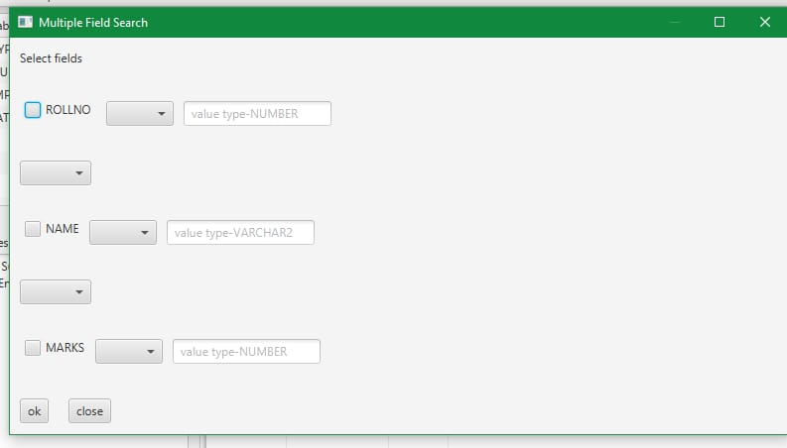
Multiple Field Search
It carries several features such as
Select Fields
Roll No.
Name
Marks

Slide 11
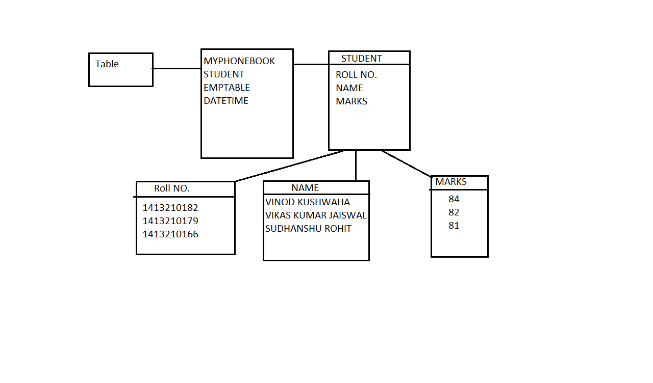
Database Design
It is a design which gives the overview of the database

Slide 12
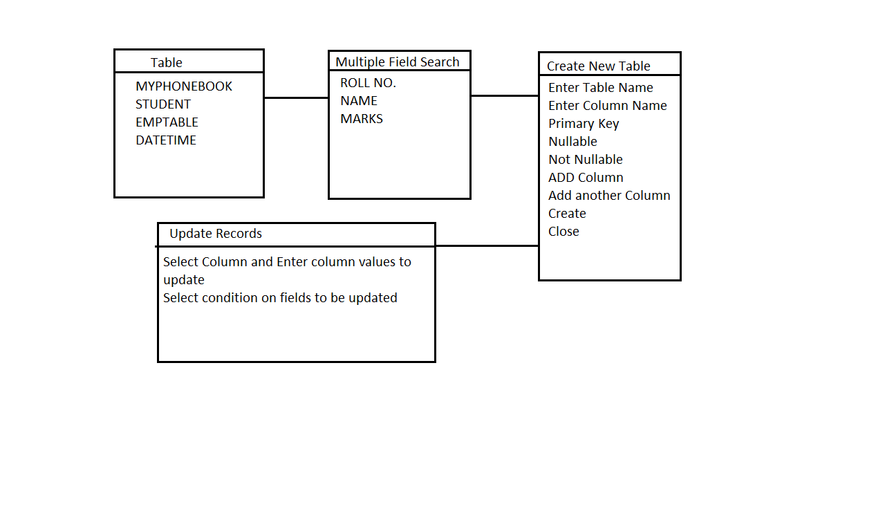
UML Design
Unified Modeling Language is a standarized modeling language enabling developers to specify, visualize,construct and document artifacts of a software system.

Slide 13
Testing
The Application is required these testing
Unit Testing
Integration Testing
System Testing

Slide 14
Conclusion
Conclusion
Last but not the least it can be said that the Query Builder will ease in keeping or putting the data into the database without writing the code and by just clicking the button the query will be fired and the data will be stored in the database.

Slide 15
THANK YOU

